Slide 1
Twitch Streaming Analysis
By:
Group M
Tanmay Sakharkar Prachi Patankar
Rajat Marathe Gandhali Kokate
Atharva Tilak Gautam Bhatia
Notes:
AT

Slide 2
Analysis Processes
01
02
03
04
05
Dataset selection
Data cleaning and preprocessing
Perform descriptive statistics
Perform aggregation based on games
Perform aggregation based on years
Notes:
AT

Slide 3

DATASET SELECTION
The gaming industry has witnessed explosive growth in revenue in recent years.
As per estimates, the gaming industry is set to overtake the film and music industry in the upcoming years.
All the related industries are also expected to grow.
Twitch is an online video streaming platform on which content creators or “streamers” can live stream content which includes a wide variety of categories ranging from video games to cooking.
Notes:
TS

Slide 4
Data source : https://www.kaggle.com/datasets/rankirsh/evolution-of-top-games-on-twitch
We decided to use monthly data from Twitch, specifically from years 2016-2023, to analyze and detect trends over 8 years.
The monthly data contains the top 200 games by viewer count and some other statistics like peak viewers, number of streamers, hours watched, etc.
This dataset allowed us to analyze the above mentioned metrics across different years and for all of the highly ranked games.
Notes:
TS

Slide 5
DATA DESCRIPTION
-Rank - Rank of a game in a month based on hours watched
-Game - Name of the Game
-Month - Months of each year
-Year - Year from 2017 to 2023
-Hours_watched - Total number of hours watched of a particular game
-Hours_streamed - Total number of hours streamed of a particular game
-Peak_viewers - Peak viewers of a particular game
-Peak_channels - Peak channels streaming a particular game
-Streamers - Number of streamers of a particular game
-Avg_viewers - Average viewers in a month
-Avg_channels - Average channels streaming a game
-Avg_viewer_ratio - Ratio of average number of viewers for each channel
Notes:
GB

Slide 6
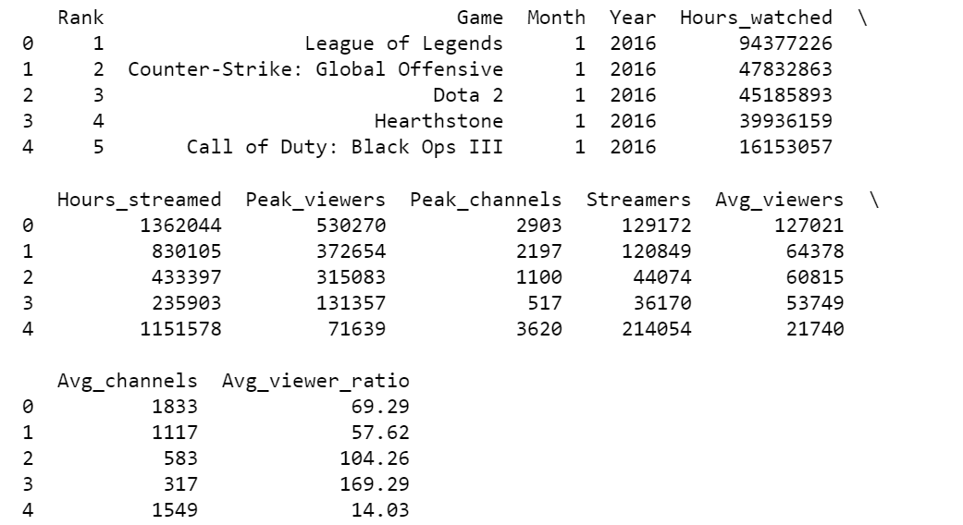
DATA DESCRIPTION
Notes:
GB

Slide 7
Data Cleaning and Preprocessing
We performed certain steps to clean and pre-process the data before starting with our exploratory data analysis. These steps included-
Keep only the top 100 ranked games for each month in all years
Check and account for special characters in Game names
Check and resolve missing data for all of the available columns
Check and resolve NA values for all available columns
Remove ‘Just Chatting’ from the results as it skewed all of our analytics results.
Notes:
GB

Slide 8
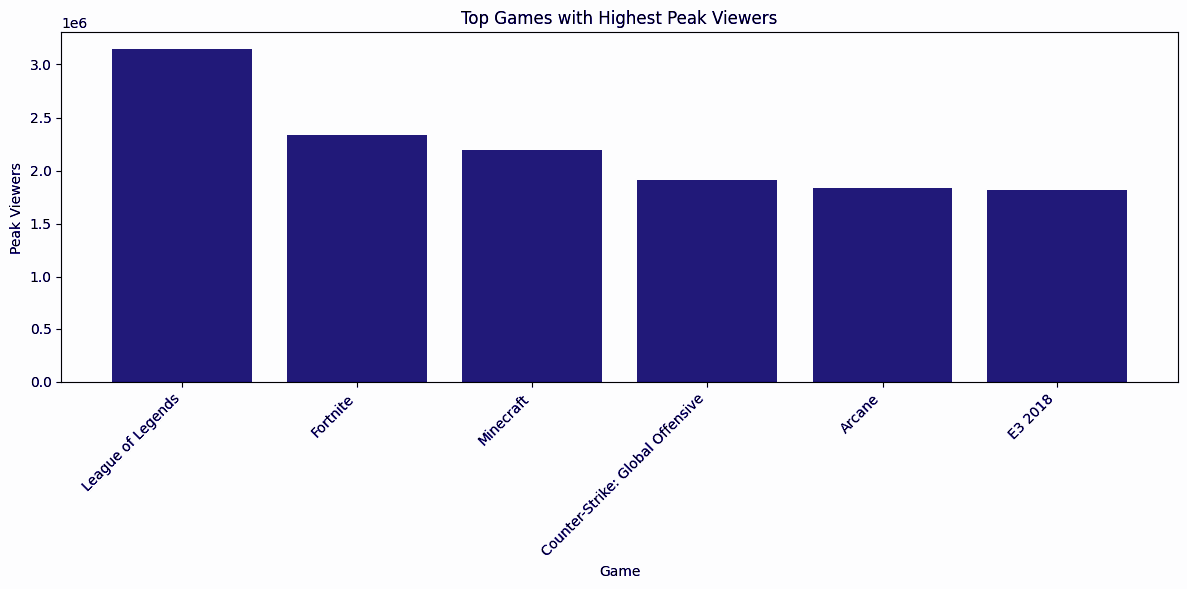
1.Top Games with Highest Peak Viewers
Notes:
GK

Slide 9
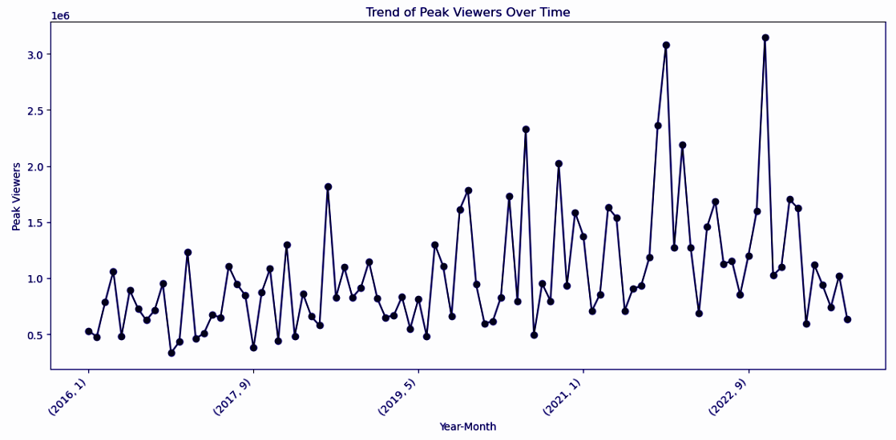
2.Trend of Peak Viewers Over Time
Notes:
GK

Slide 10
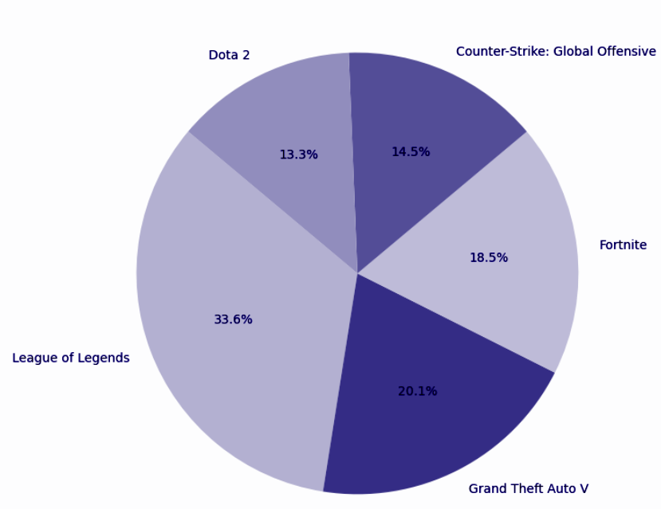
3.Distribution of Total Hours Watched for Top 5 Games
Notes:
RM

Slide 11
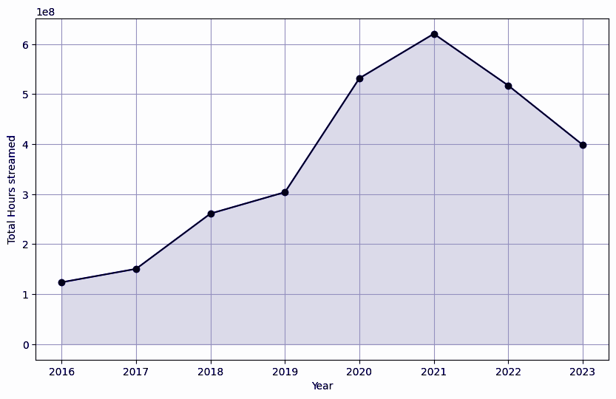
4.Total Hours streamed by Year
Notes:
RM

Slide 12
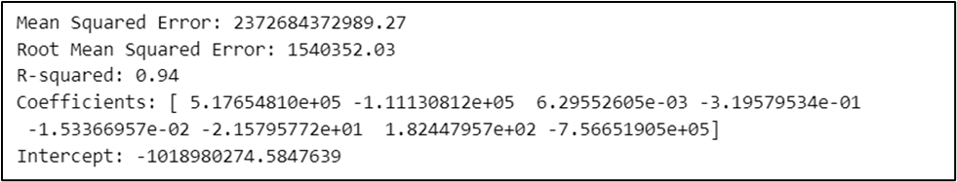
Building a regression model
Using this regression model, we attempt to predict the number of ‘streams’ in the future .
We separate the features (X) by excluding the 'Streams' column, and the target variable (y) is set to the 'Streams' column.
Overall, the model appears to perform well based on the evaluation metrics below:
Notes:
RM

Slide 13
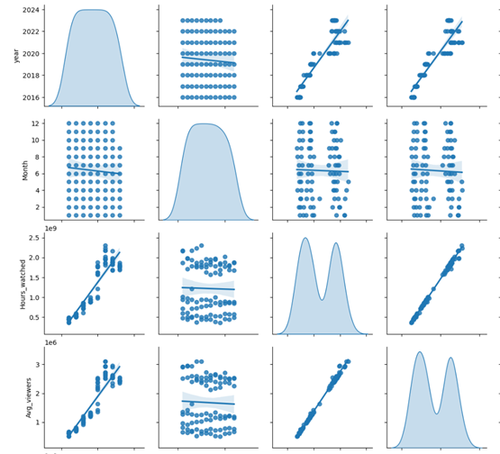
Pair Plot with Regression Line
Notes:
RM

Slide 14
Summary
Average viewers over the years is 12821.34 .
League of Legends are the most popular amongst viewers across all years.
Viewership saw a high rise in 2021.
2021 has recorded the highest streaming time on Twitch.
The data is not categorized enough to perform clustering.
It is recommended to collect more descriptive data to perform a better regression analysis in the future.
Notes:
PP

Slide 15
THANK YOU!
Notes:
All

